Slide 1
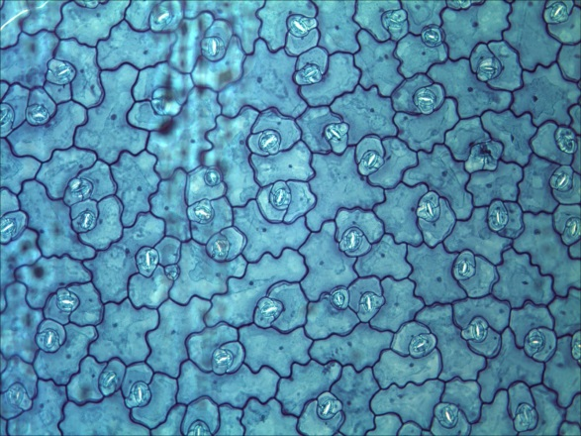
Simple permanent tissue
vi. Surface tissue :
The entire surface of the plant consists of a single layer of cells called surface tissue or epidermis.
Most of the epidermal cells are relatively flat.
The outer and lateral walls of the cell are often thicker than the inner wall.
The cells forms a continuous sheet without intercellular spaces.
It protects all parts of the plants.
Space between the cells

Slide 2
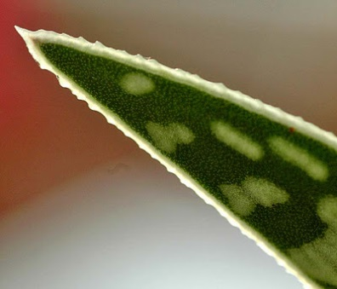
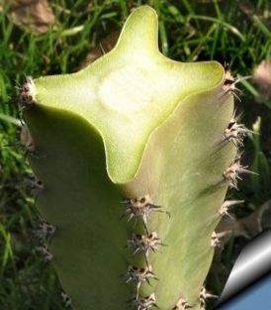
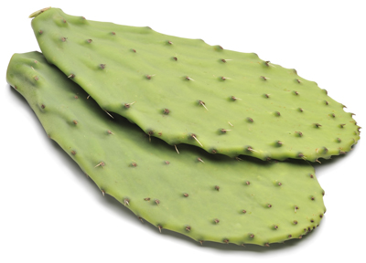
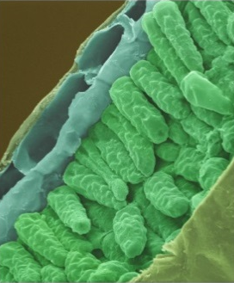
Simple permanent tissue
Thick epidermis
Waxy cuticle
vi. Surface tissue :
In some plants growing in very dry habitats, like cactus, the epidermis may be thicker to prevent water loss.
Epidermal cells on the aerial parts of the plant often secrete a waxy, water resistant layer on their outer surface.
This layer helps in protection against loss of water, mechanical injury and invasion of parasitic fungi.

Slide 3
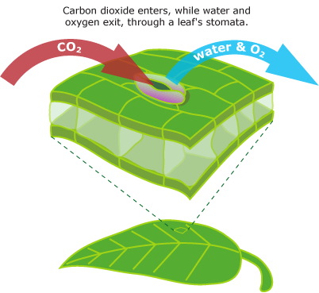

Simple permanent tissue
vi. Surface tissue :
In order to exchange gases with the atmosphere, epidermis has minute openings called stomata.
The stomata are enclosed by two epidermal kidney shaped cells called guard cells.
They control the opening and closing of the stomata.
Transpiration also takes place through stomata.
Guard cells
Loss of water
H₂O
H₂O
H₂O
H₂O
H₂O
H₂O
H₂O
H₂O

